Slide 1


Games of Thrones Analytics Social Media Intelligence-Esc Rennes School of Business
XIE Bomin
ZHANG Jing
SHARMA Kanika
GOVINDHAN Muthu

Slide 2


CONTENT
Introduction
Extraction of Tweets Through API
Data Cleaning
Sentiment Evaluation
Sentiment Visualization
Corpus Creation
Word Cloud
Frequency of word Negative and positive
Classification by Naïve Bayes
Accurecy of Model
Conclution

Slide 3
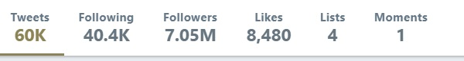
INTRODUCTION
Twitter is a popular microblogging site and it is online news and social networking service where users post and interact with messages, known as “tweets”.
Begging of the Twitter there is a limit to use the text 140 characters but on November 7, 2017, it was double to 280 characters for all languages expect Japanese, Korean and Chinese.

Slide 4
INTRODUCTION
The Twitter is web site interface, Short message Service (SMS) and mobile device application software (App).
The Game of Thrones is an American fantasy drama television series, which is adaption song of Ice and Fire. It is based on George R.R Martin’s series of fantasy novel.
The first part they released 2011 for United Kingdom, Canada, Malta, Morocco, Spain and the united states.
Twitter Game of Thrones is very famous and you can see how much tweets, following,followers, Likes.

Slide 5
Target Audience
The primary target audience for the campaign are 24-44 year olds described as
“Educated, technology dependent, always on the move”
This information is based on Kantar Media’s TGI database where the index was
greater than 120 for demographics, psychographics and geographic specifically for
Sky Atlantic customers who purchase Blu-Ray/DVDs and watch Game of Thrones.
Adopting an integrated approach, the best way to advertise to this audience, will
be through the means of:
Advertising (Online, OOH, traditional)
Social Media
Public Relations
Direct Marketing

Slide 6
Promotional campaign and
strategy
Advertising
• Broadcast (7th March – 21st March)
• Print (7Th March – 21st March)
• Online (7Th March – 28th March)
• OOH (7th March – 28th March)
Direct Marketing
• HBO mailing list (7th March and 14th March)
• Retail outlets (11th March)

Slide 7
Promotional campaign and
strategy
Social Media
• Snapchat (7th March – 21st March)
• Buzzfeed (7th March – 14th March)
• Facebook (14th March – 28th March)
• Twitter (14th March – 28th March)
Public Relations
• O2 arena (7th March – 13th March)
• Madame Tussauds (14th March)

Slide 8
Price and distribution
Pricing strategy
The pricing strategy for the campaign will adopt a psychological pricing approach which will be based on the perceived price barriers that customers may have.
The pricing will be as followed:
• Standard DVD - £24.99
• Blu-Ray DVD - £29.99
• Seasons 1-5 Box set range from £70-£100

Slide 9
Price and distribution
Online Distributors
• Amazon
• HBO Shop
• HMV
• Supermarkets (Online and Offline)
• Zavvi
Offline Distributors
• HMV
• Independent retailers
• Argos

Slide 10
Measurement and Control
The success of the campaign will be monitored using various tools and analytics made available for HBO from the different forms of media used in the campaign. This will not only ensure that different targets are met but will also identify KPIs which can be made comparable to previous campaigns.
Measurement and control for the campaign will be categorised as:
• Online advertising
• Offline advertising
• Social Media
• Direct Marketing
• Brand engagement
• Sales volume

Slide 11
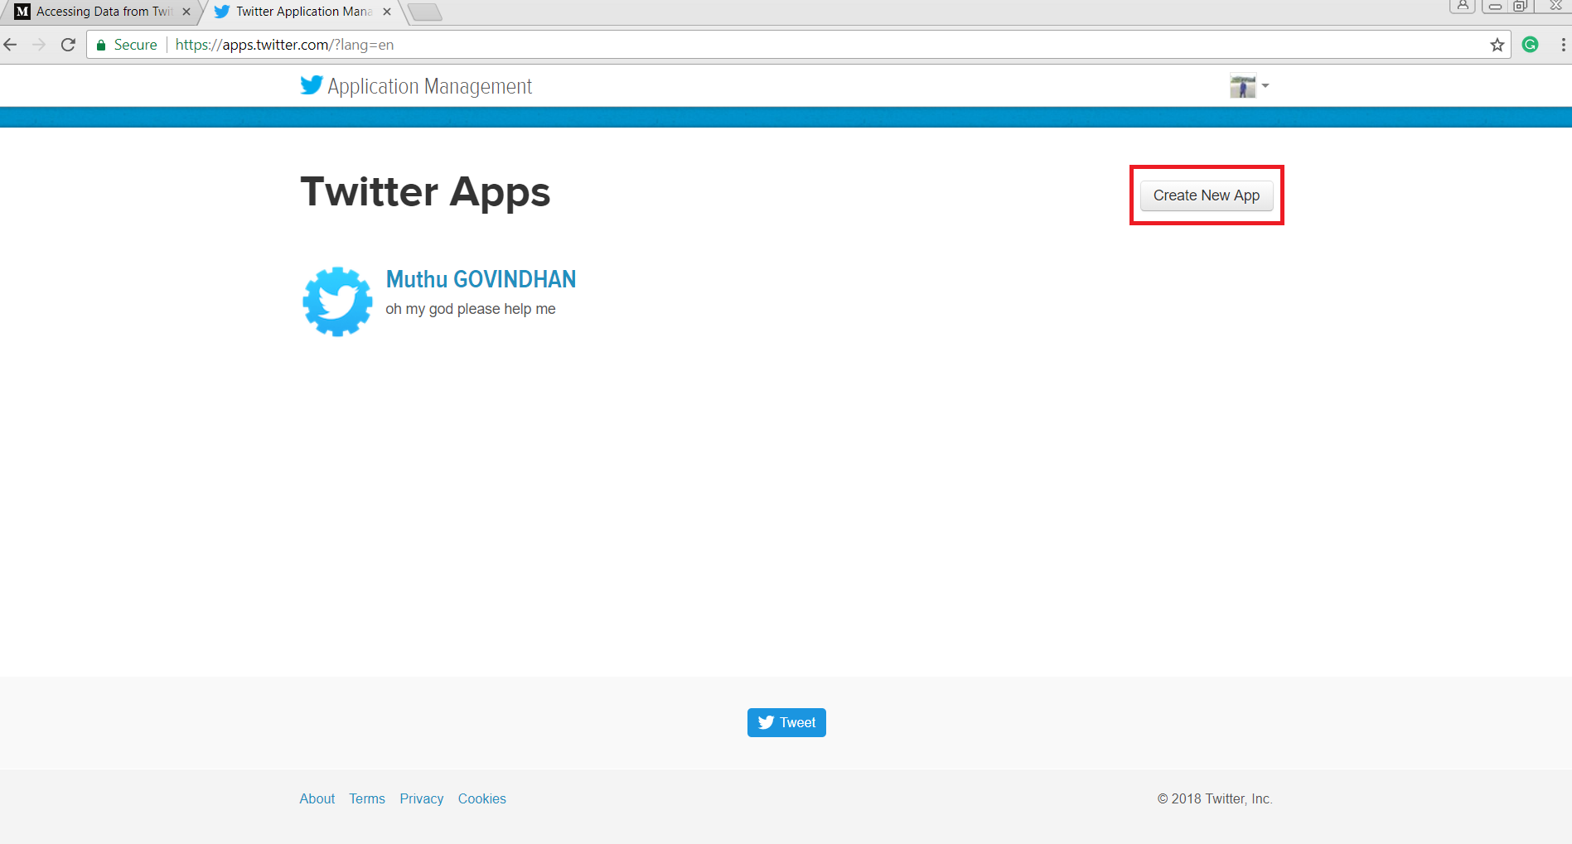
Extraction of Tweets Through API

Slide 12
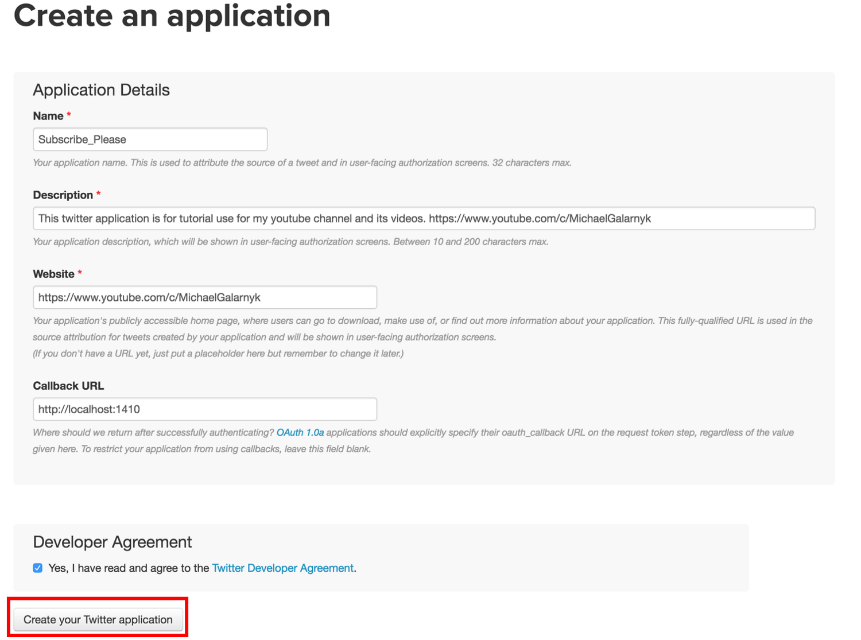
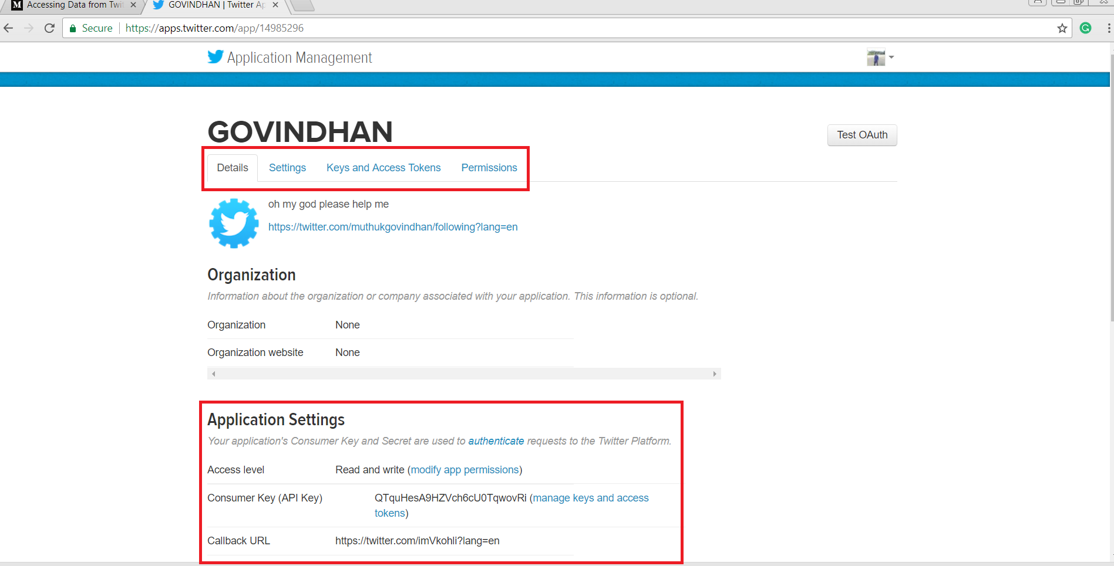
Extraction of Tweets Through API

Slide 13
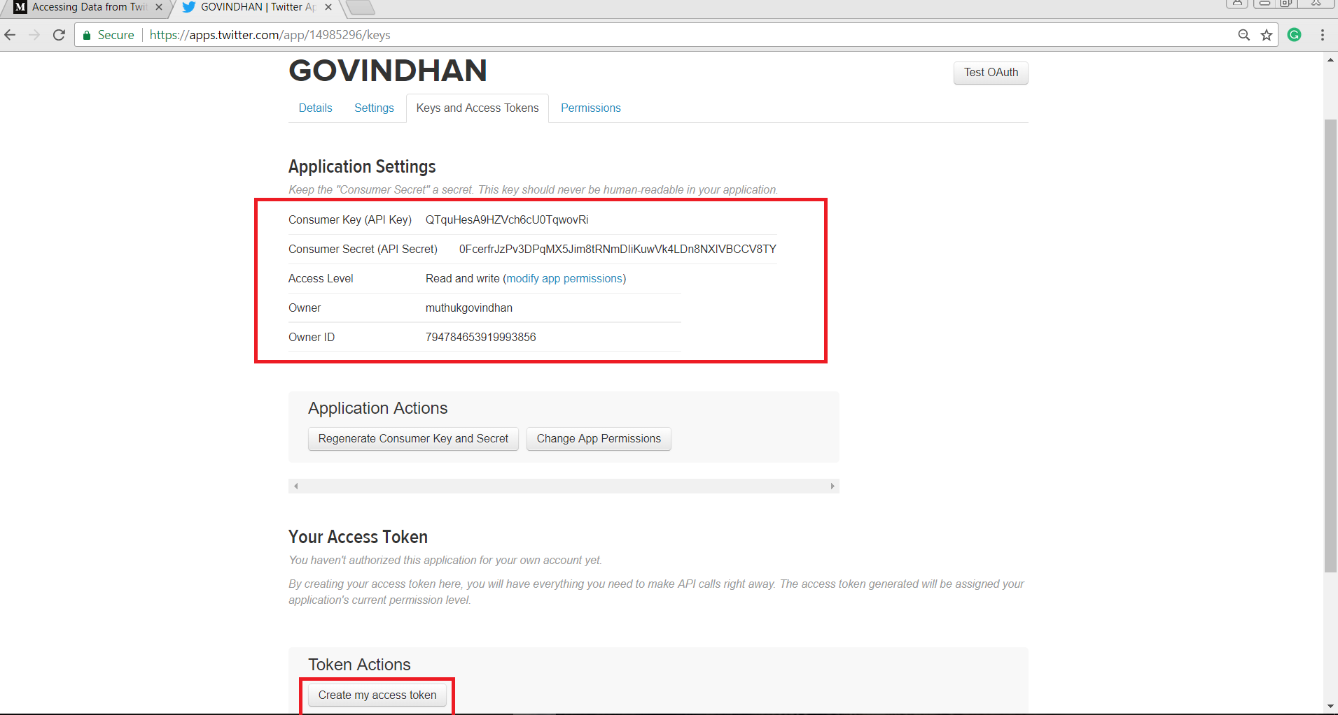
Access Key/Secret/URL

Slide 14
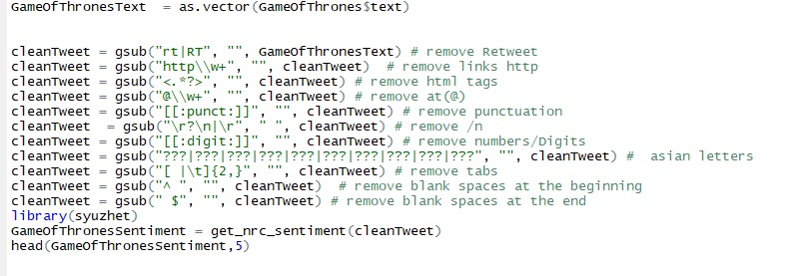
Data Cleaning
We are removed (Retweet, links http, html tags, at (@), ponctuation, /n, numbers/Digits, tabs, blank spaces at the beginning and the blank space at the end) because if we are not remove this all we are facing the problem word cloud.

Slide 15
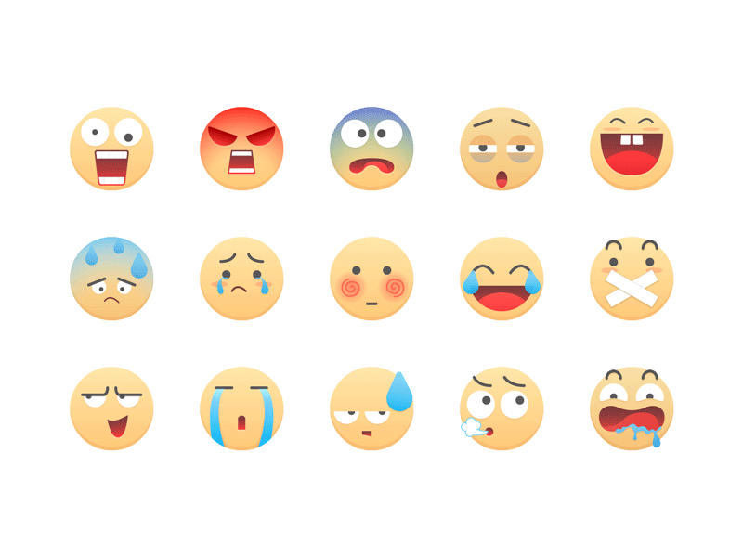
Sentiment Analysis
A dictionary is used that associates the words to eight different emotions and a negative/Positive sentiment.
The Word-Emotion Association of Saif Mohammad and Peter Turney.

Slide 16

Sentiment Analysis

Slide 17
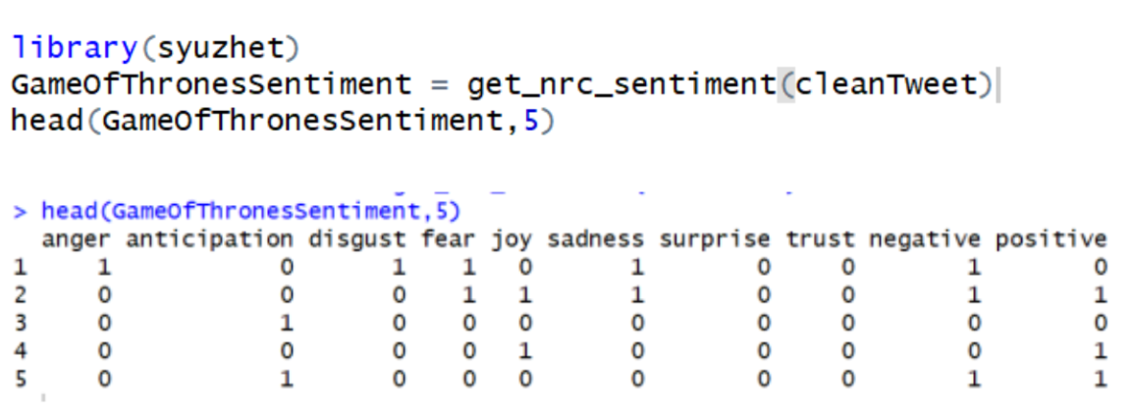
Sentiment Analysis
4.1 Sentiment Evaluation
First line
"I hate 'game of thrones', a incredible and deceiving movie."
Fourth line
"'game of thrones' is interesting and nice movie".
People's emotions are very complex or even contradictory. In general, different people have different understandings and views on the same thing, but even the same person can produce a variety of emotions.

Slide 18
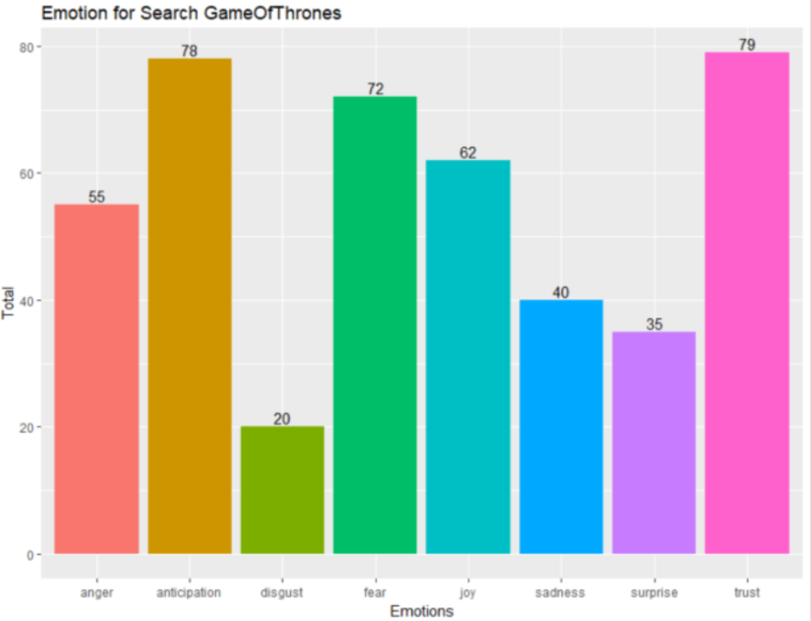
Sentiment Analysis
4.2 Sentiment Visualization
Most people showed the feeling of trust, followed by anticipation.
The least people show disgust, which is easy to understand because it is a fantastique tv drama.

Slide 19
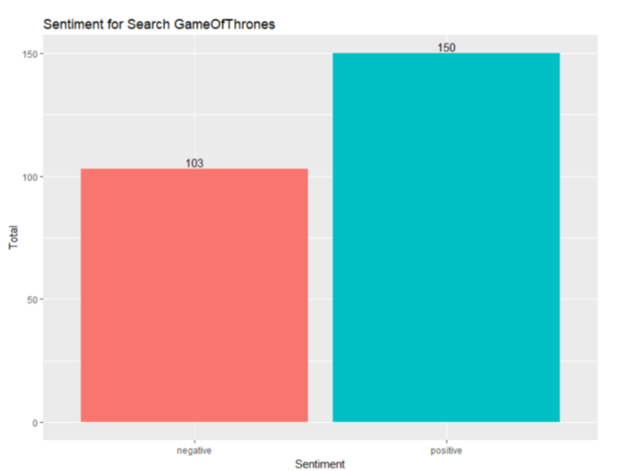
Sentiment Analysis
4.2 Sentiment Visualization
Although there are many positive and negative emotions.
By comparison, more people show positive emotions. In other words, more people like the film. Popularly speaking, if we judge a TV play only from the audience's preferences, it is successful.

Slide 20

Classification Accuracy

Slide 21

Classification and Accuracy
Necessary R packages
E1071
The e1071 package did a good job of implementing the naive bayes method.
DTM
Transforming texts to documentterm matrix (dtm).

Slide 22
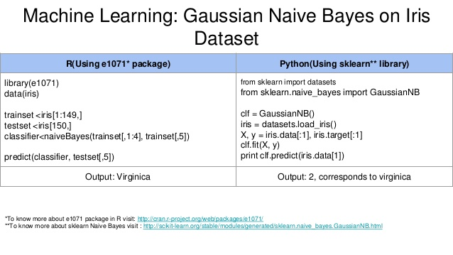
Classification and Accuracy

Slide 23
Classification and Accuracy
Data reduction
Judge whether this comment is positive or not positive, the value should be 0 or 1. Further simplify the data.
When the value is greater than 0,
it becomes 1.
It means that the comment is positive.

Slide 24
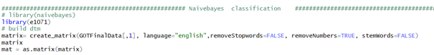
Classification and Accuracy
NaiveBayes classifation and accuracy
Train the naive Bayes model with the training set. e1071 asks the response variable to be numeric or factor.
convert characters to factors.

Slide 25
Classification and Accuracy
Now we can step further to test the accuracy.
recall_accuracy= 0.4
The value is too low, so we try other methods.

Slide 26
The other models
RTextTools package
Algorithm:
Svm; bagging; random forests;
decision trees; maximum entropy
Method : cross validation

Slide 27
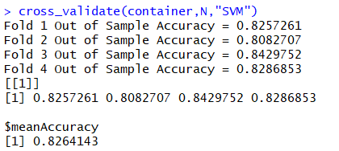
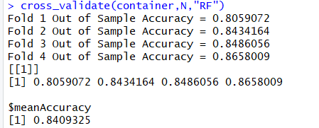
The other models
(1) SVM (2) Forest

Slide 28
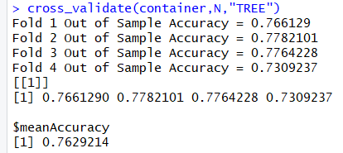
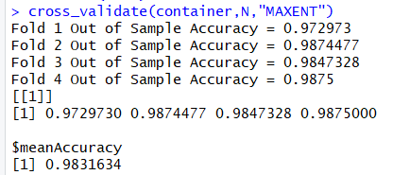
The other models
(1) Decision tree (2) MAXENT

Slide 29
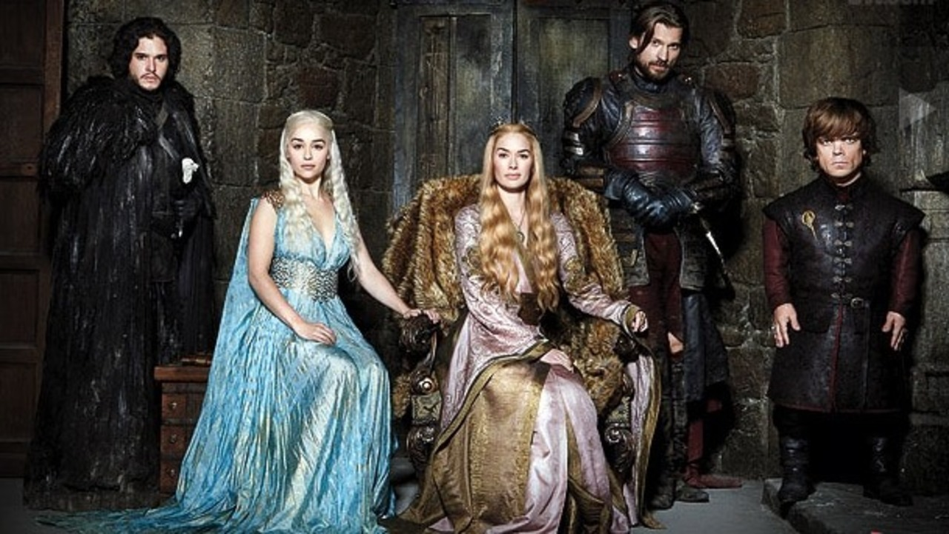
Word Tokenization

Slide 30
Corpus Creation
Collect all the text, XML files, emails, webpages, voice recordings
Standardize the collection
Convert to lower case
Remove whitespaces
Remove stopwords

Slide 31
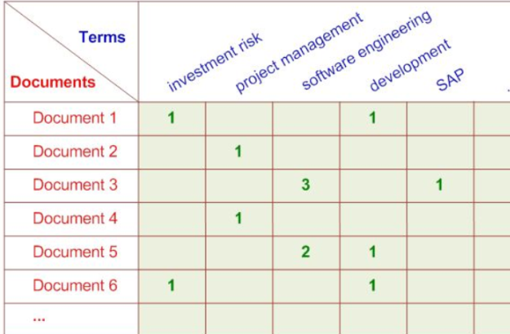
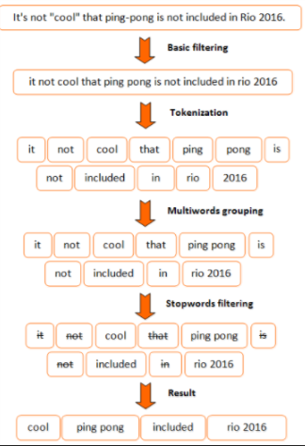
Term Document Matrix
.Build Term Document Matrix
-TDM is a sparse Matrix
Find the frequency of terms
Eliminate the terms with
less frequency

Slide 32
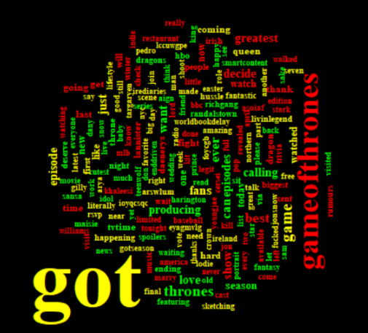
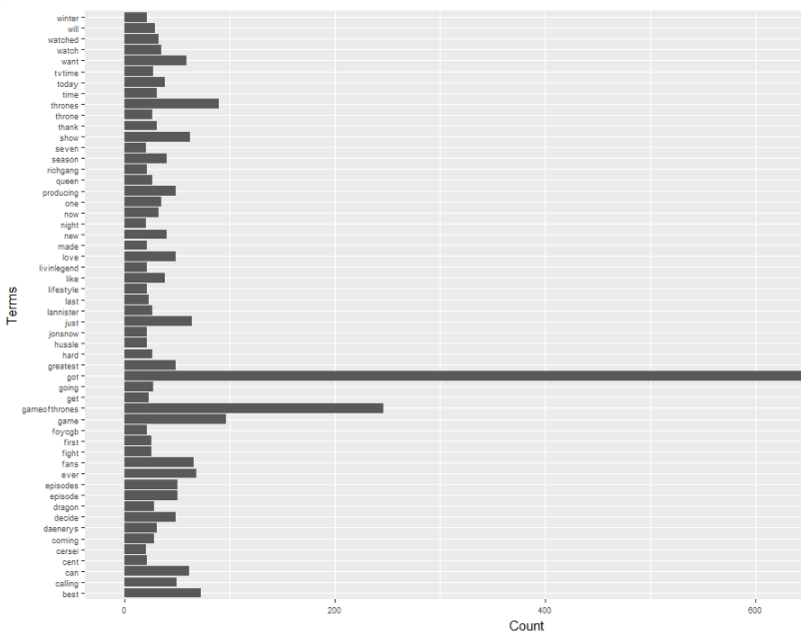
Word Frequency and Cloud
“got” , “games of thrones” , ‘greatest”, “decide” are more popular tweets

Slide 33

Network of Terms

Slide 34
Network Terminology
Visualize how tweets are connected as a network of terms.
Tweet Keywords=Nodes(or vertices)
Connections = edges

Slide 35
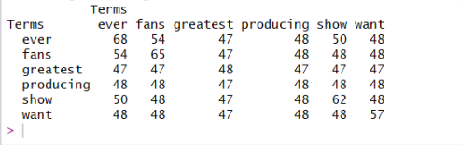
Term Network Process
Convert Term Document Matrix into tweet-tweet adjacency matrix.
tweet “ever” has 50 terms in common with tweet “show”.
Plot the network graph using igraph Package in R.

Slide 36
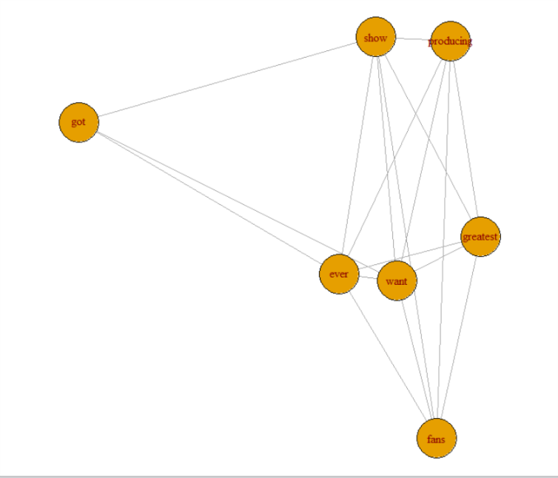
Network Graph

Slide 37
Link between users
If A Retweeted B , then there is link from A and B.
Split the data into two sets; one for mention network and other for retweet network.

Slide 38
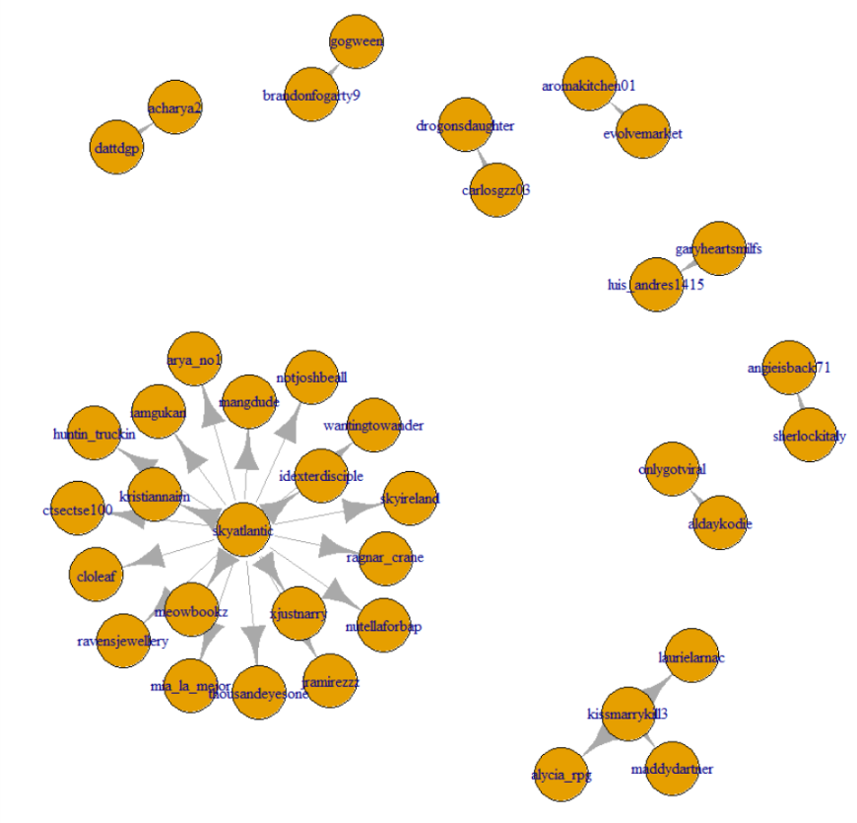
A retweeted B

Slide 39
Statistics of Network
Number of edges -437
Number of Vertices- 527
Centralization-0.037492
Betweenness Centrality
Closeness Centrality
Eigenvector Centrality

Slide 40
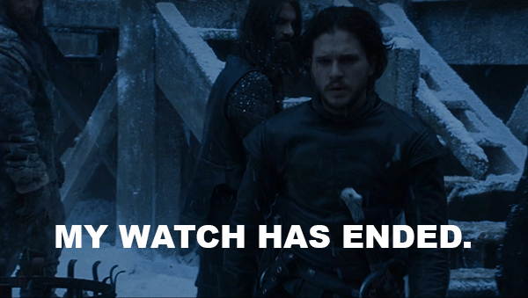
Thank you for listening

Slide 41
Reference
Ho, Tin Kam (1995). Random Decision Forests(PDF). Proceedings of the 3rd International Conference on Document Analysis and Recognition, Montreal, QC, 14–16 August 1995. pp. 278–282.
Ho TK (1998). "The Random Subspace Method for Constructing Decision Forests" (PDF). IEEE Transactions on Pattern Analysis and Machine Intelligence. 20 (8): 832–844. doi:10.1109/34.709601.
Hastie, Trevor; Tibshirani, Robert; Friedman, Jerome (2008). The Elements of Statistical Learning (2nd ed.). Springer. ISBN 0-387-95284-5.
Kleinberg E (1990). "Stochastic Discrimination" (PDF). Annals of Mathematics and Artificial Intelligence. 1 (1-4): 207–239. doi:10.1007/BF01531079.
http://blog.sciencenet.cn/blog-397960-666113.html
https://cran.r-project.org/web/packages/RTextTools/RTextTools.pdf
P. Bickel and K. Doksum. Mathematical Statistics. Prentice Hall, 2000.
D. Blei and M. Jordan. Modeling annotated data. In SIGIR, pages 127–134. ACM Press, 2003.
D. Blei and J. McAuliffe. Supervised topic models. In preparation, 2007.
Breiman, Leo. Bagging predictors. Machine Learning. 1996, 24 (2): 123–140. doi:10.1007/BF00058655. CiteSeerX: 10.1.1.32.9399.
Alfaro, E., Gámez, M. and García, N. adabag: An R package for classification with AdaBoost.M1, AdaBoost-SAMME and Bagging. 2012.

